Slide 1

2008 to 2021 Netflix Data:
Cleaning, Analysis and Visualization
Group 7 EDA Project
Clemson Ayegbusi
Oyekunbi Onigbinde
Ademuyiwa Onigbinde
Ifeoma Okafor
Akanimo Nya
September 9, 2022
10Alyticsgroup7@gmail.com

Slide 2
Executive Summary
Netflix is the world's leading streaming platform offering TV shows and movies. This project is aimed at advising the organization to take informed business decisions in order to expand their contents, increase viewing rate and maximize profit. Netflix dataset from 2008 to 2021 in several countries will be cleaned and analyzed using python tools, and data visualization libraries.

Slide 3
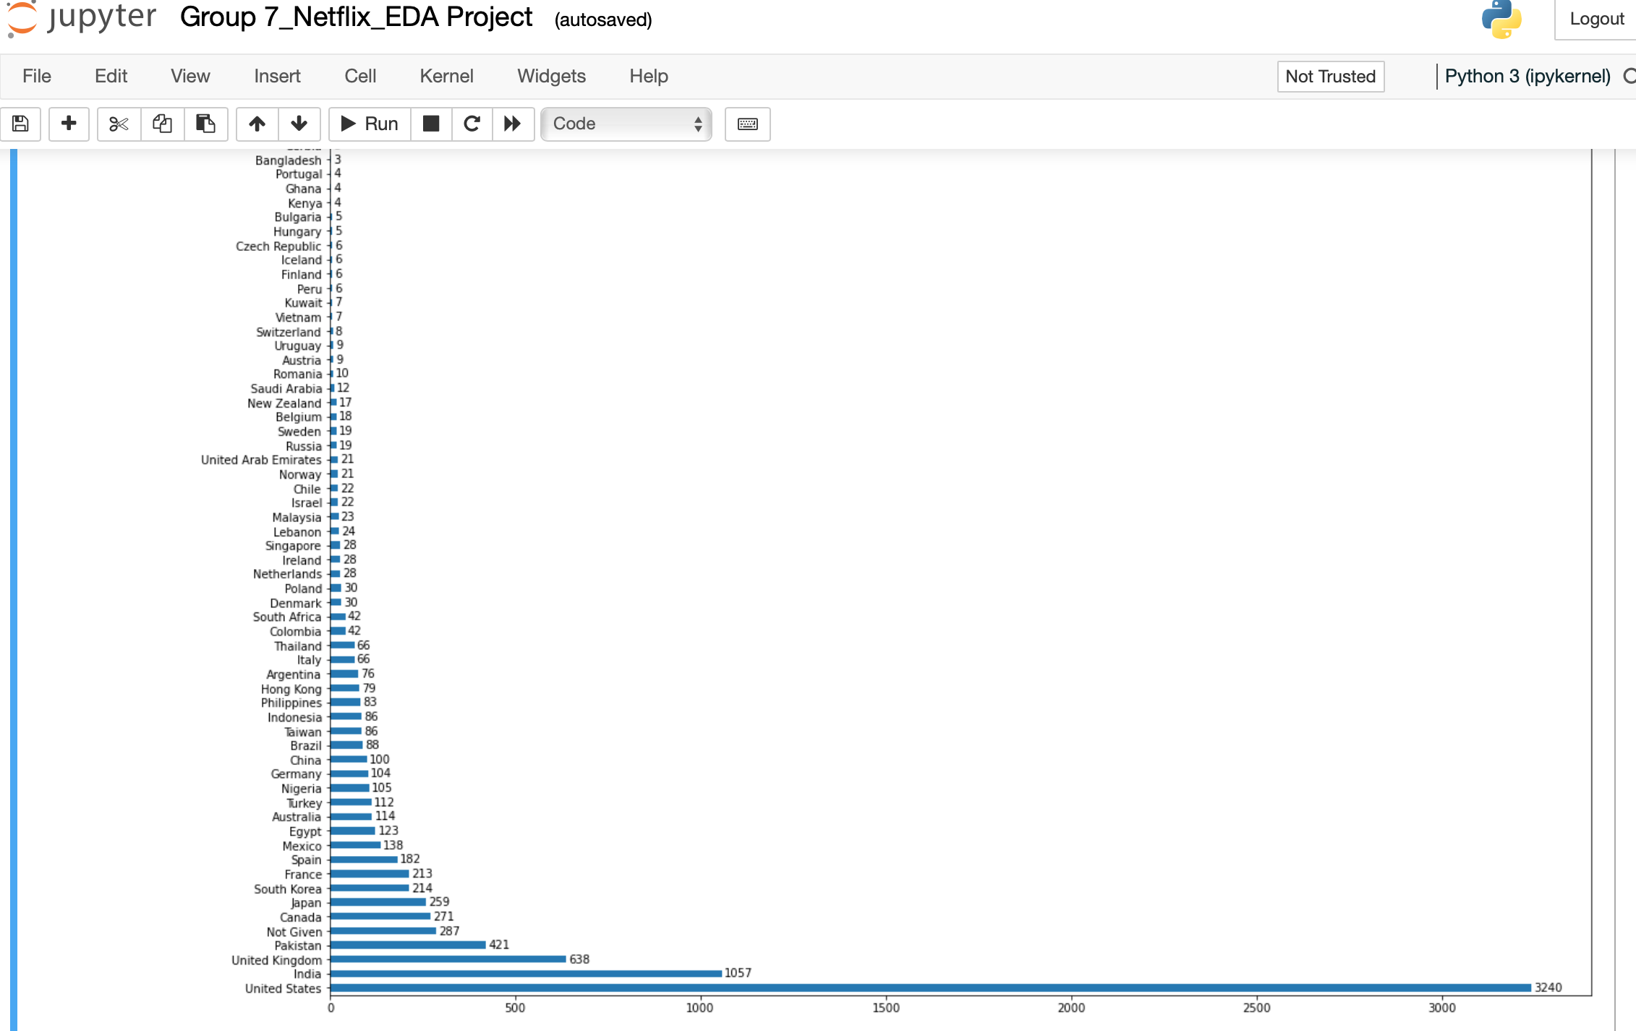
Visualization and Analysis
Movies subscription in countries around the world

Slide 4
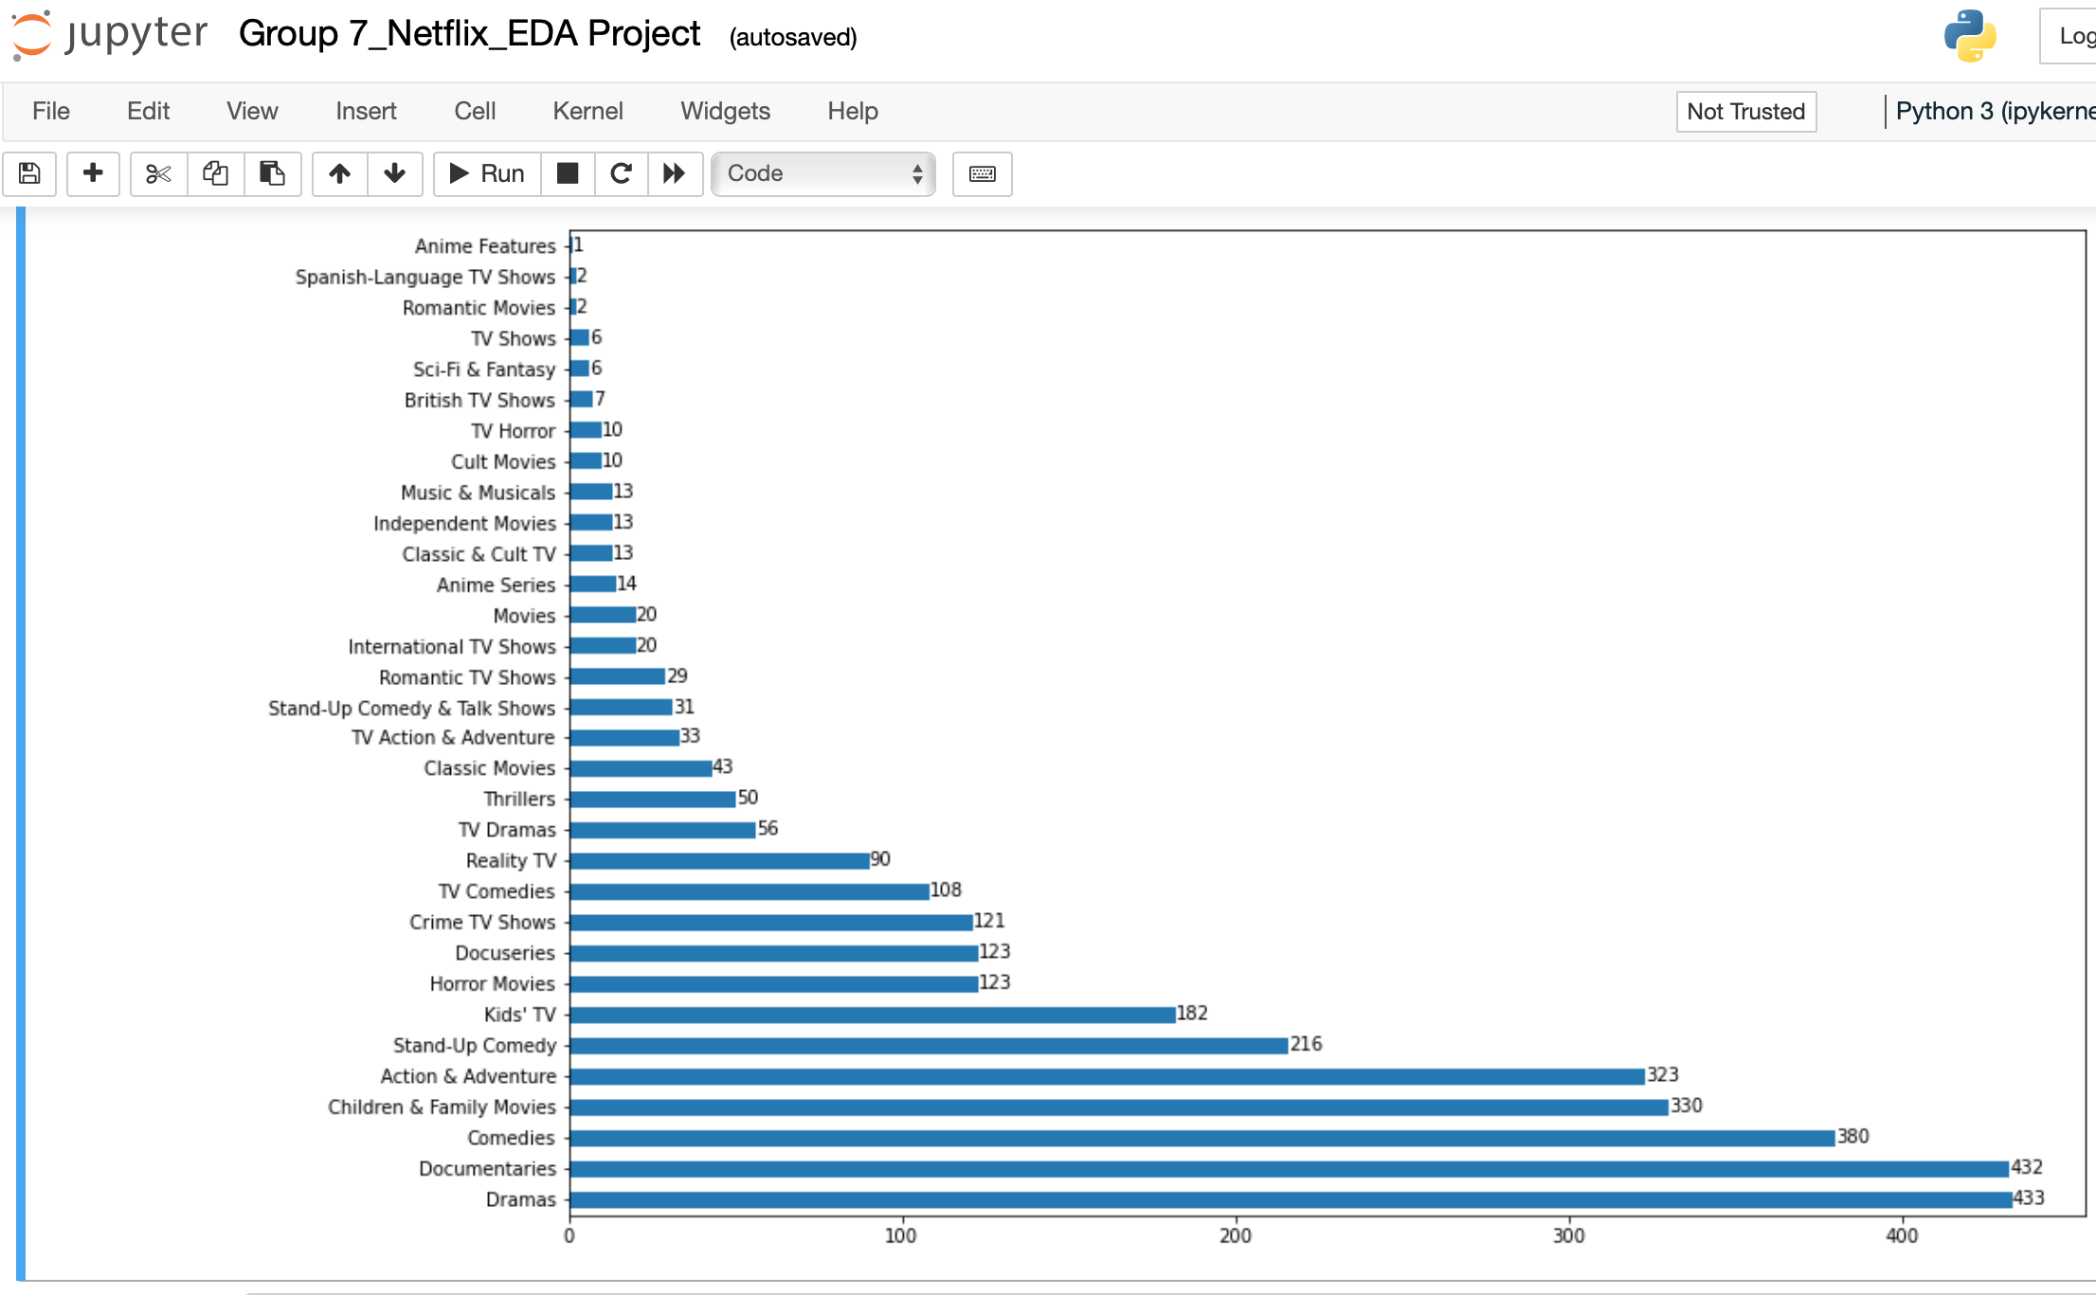
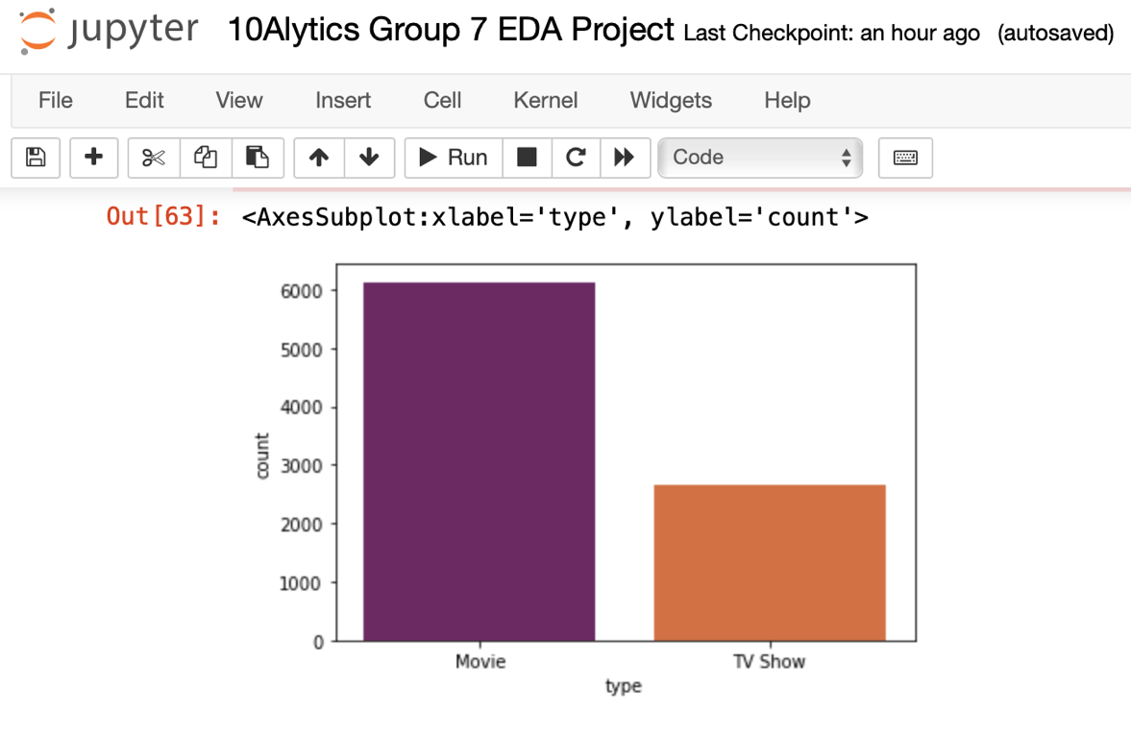
Visualization and Analysis
Two major film types in countries around the world
Film series viewed in countries around the world

Slide 5
Findings and Conclusion
2008-2011 Netflix dataset shows that customers around the world watch two types of film, i.e. movies and the tv shows.
Customers subscribed more to movies than tv shows.
The United States emerged as the leading country that releases the most films (32240) followed by India (1057). It also has the largest movie directors and with the highest customer subscriptions on Netflix.
We created a column named month and discovered that customers around the world have the highest subscription in the month of July.
In conclusion, Netflix should sustain their large market in the United States by giving incentives to customers and commit to releasing the three kinds of movie they watch most which are independent movies, comedies and dramas.
Reference: https://www.kaggle.com/datasets/ariyoomotade/netflix-data-cleaning-analysis-and-visualization

